Slide 1
Group name: Used-car EDA Shiny App
Purpose: To aid consumers with making purchasing decisions about second-hand cars.
Research questions:
What are the most common customers preferences when buying used cars?
Given the preferences of customers, what types of cars can be considered? <- alter to what prices are expected?
Used-car dataset: https://www.kaggle.com/datasets/austinreese/craigslist-carstrucks-data

Slide 2

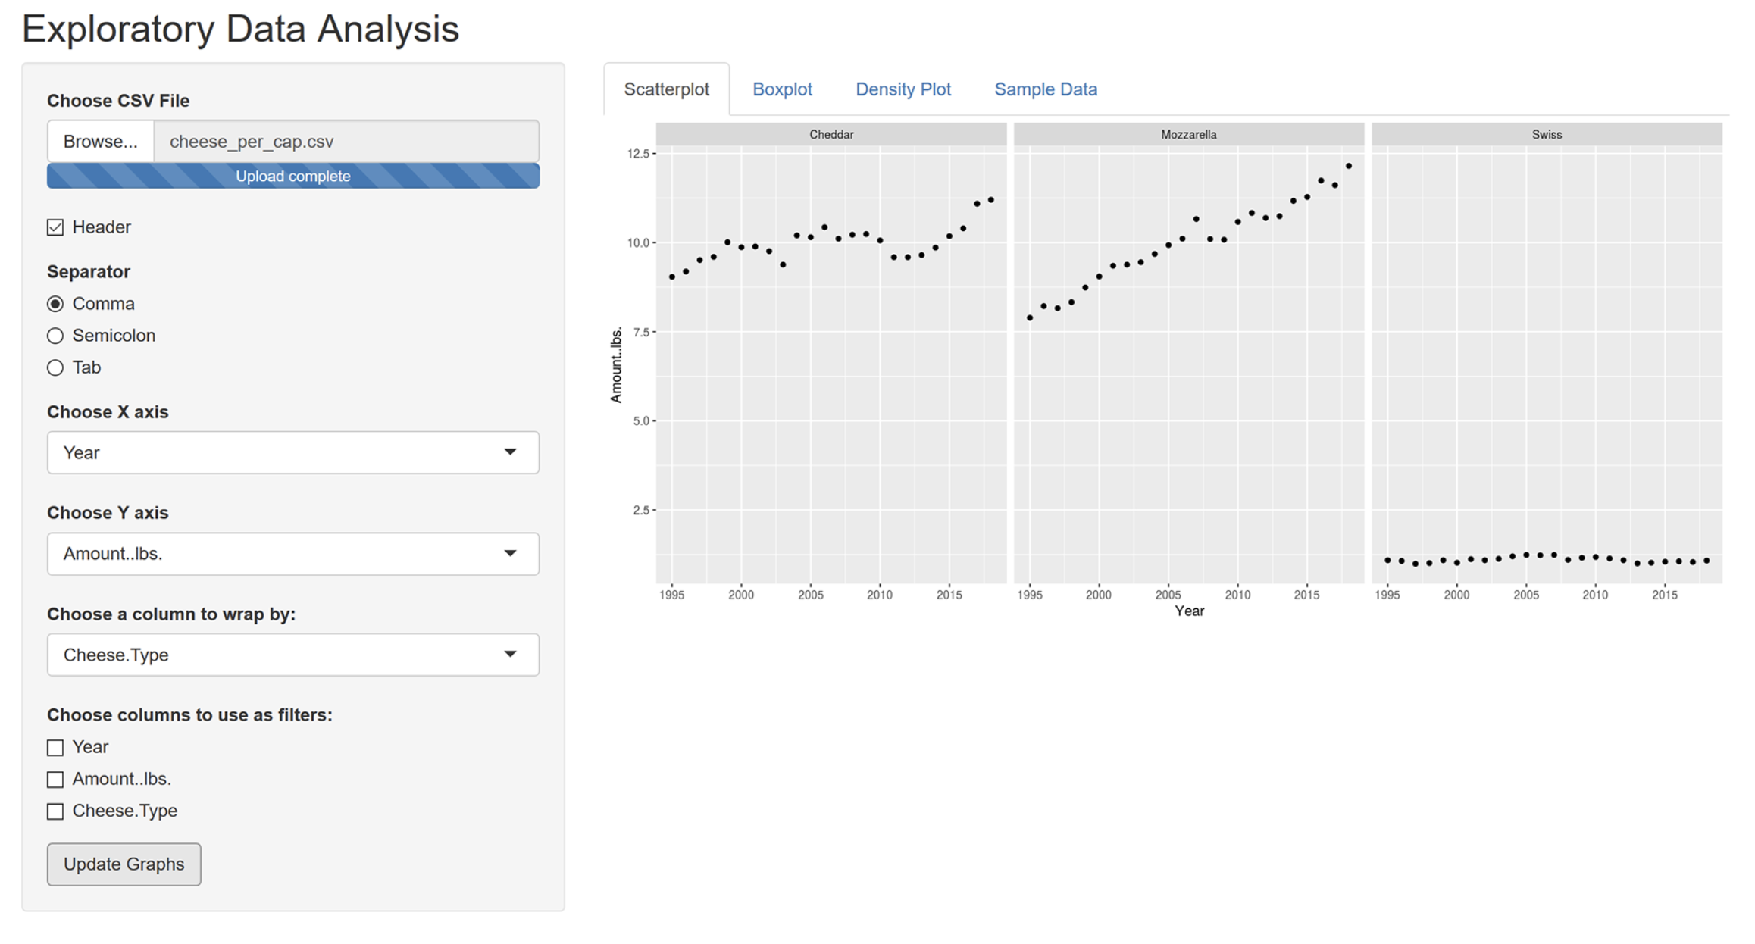
Group name
Menu Bar
EDA etc.
Documentation
OR
Tab
https://olivermelallen.com/shiny-app-for-exploratory-data-analysis

Slide 3
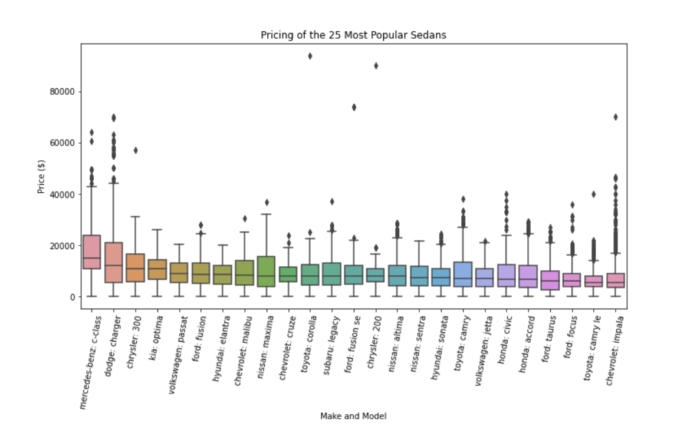
Other visualisations
https://www.kaggle.com/code/alexandersylvester/used-cars-eda-with-depreciation-analysis
Price for top 20 [models]-> dropdown box
Box and whisker/ basic bar plot

Slide 4
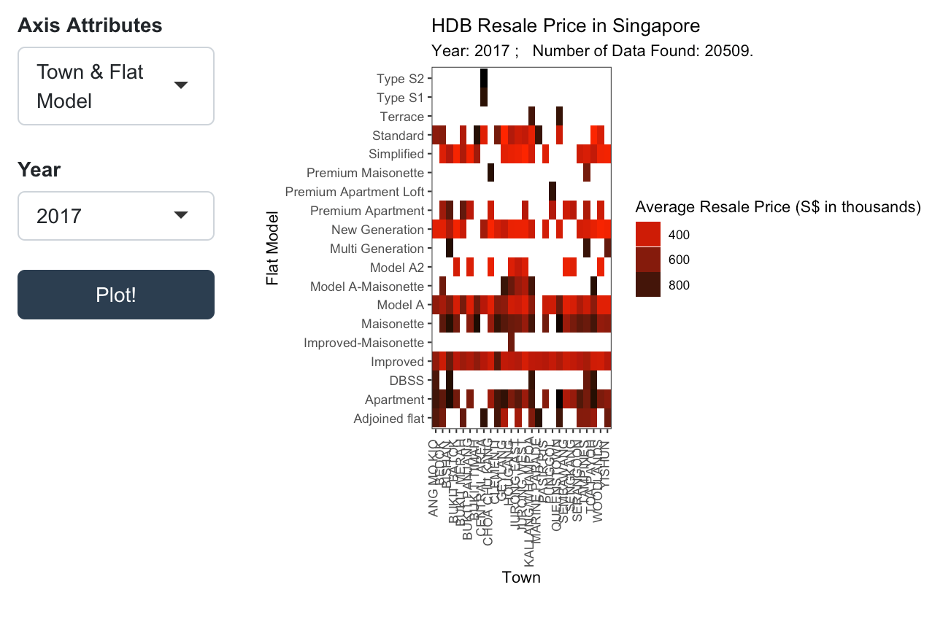
Other visualisations
Price heat map
-Correlation matrix through a heatmap
(challenging- prediction)

Slide 5
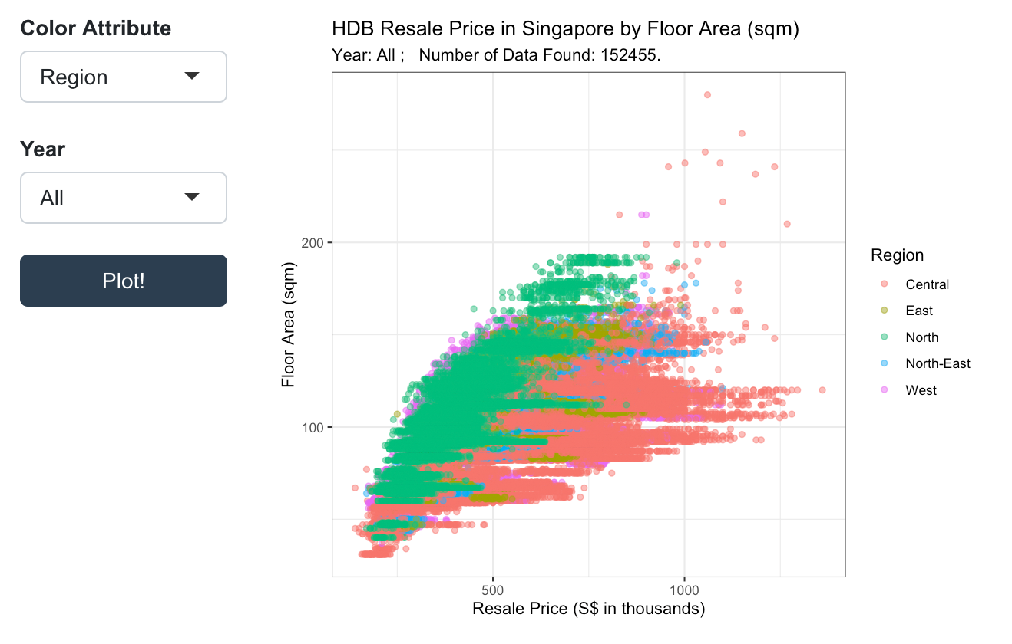
Other visualisations
price scatter plot
Age of car (year) &
Odometer (how far travelled) = this is
Meausring how heavily used is the car vs price
(wear and tear)

Slide 6
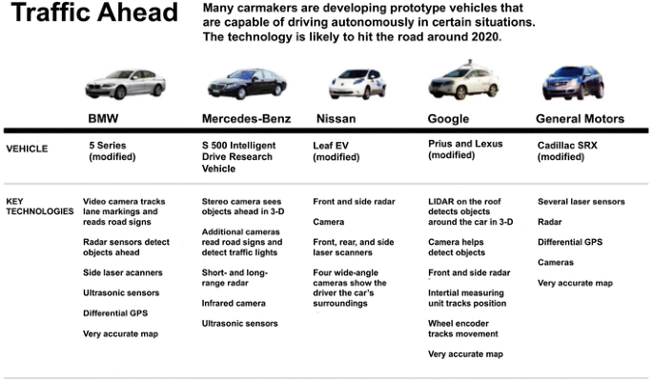
Other visualisations
Most common appearance of [model] <- dropdown menu
Gives summary of most common:
Size
Paint colour
Model
Condition
Cylinders
Fuel

Slide 7
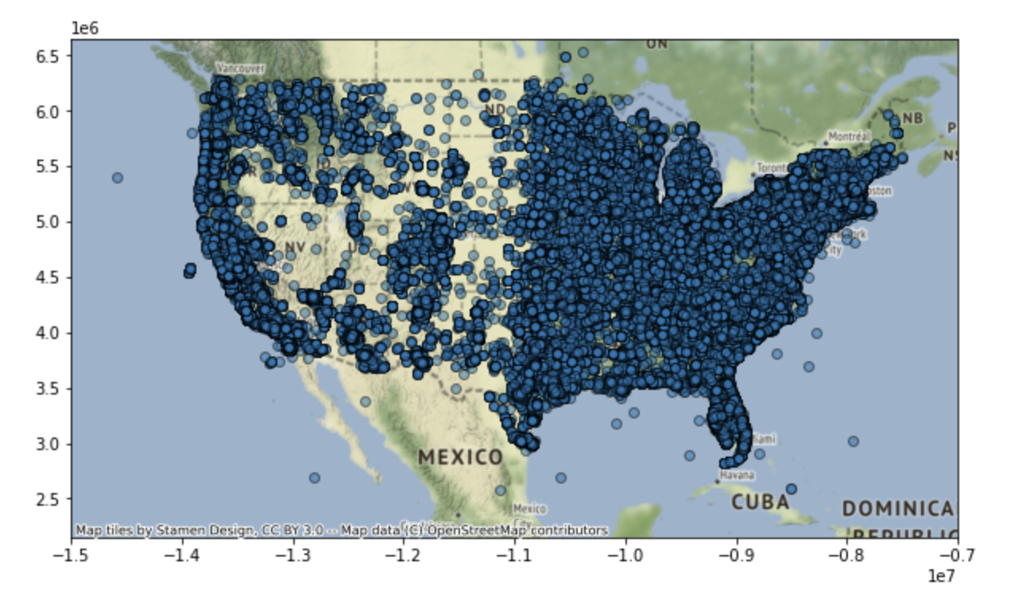
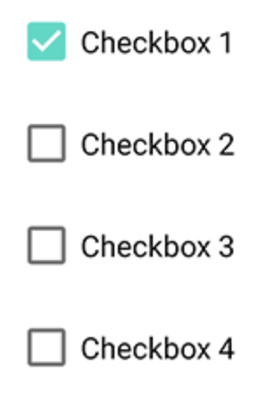
Other visualisations
Geographic distribution of vehicles [models or type of vehicles] <- checkboxes
Models/ types of vehicles

